Slide 1

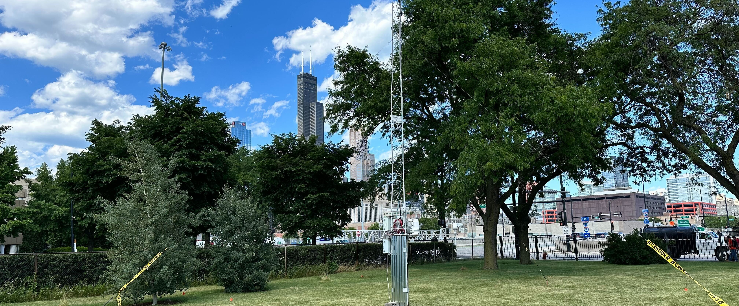
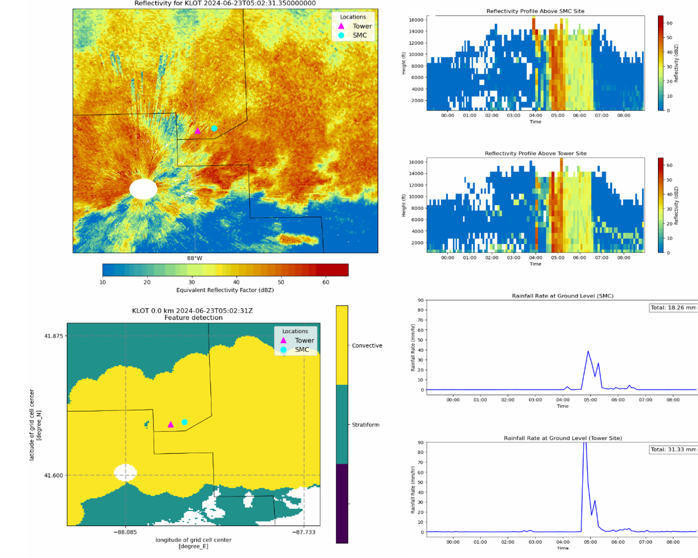
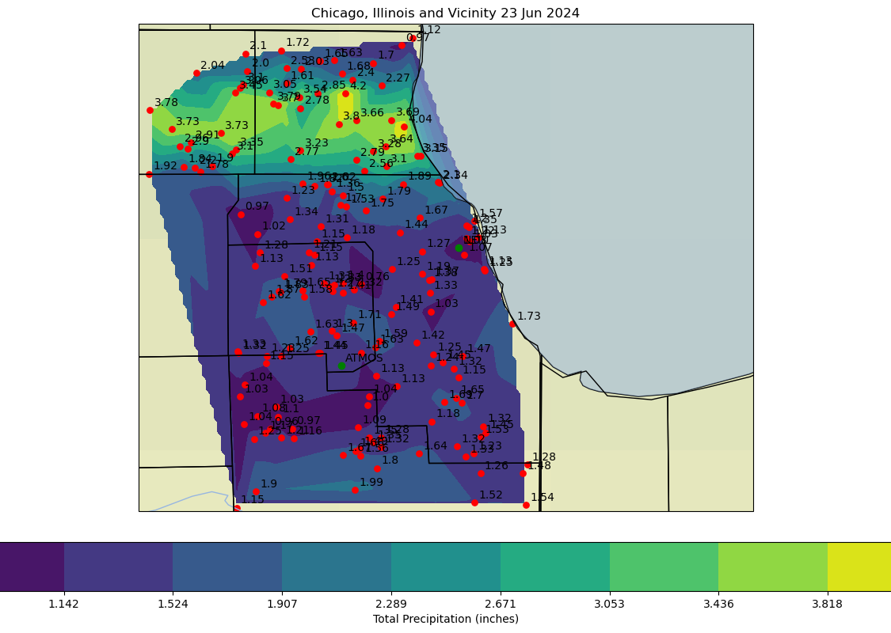
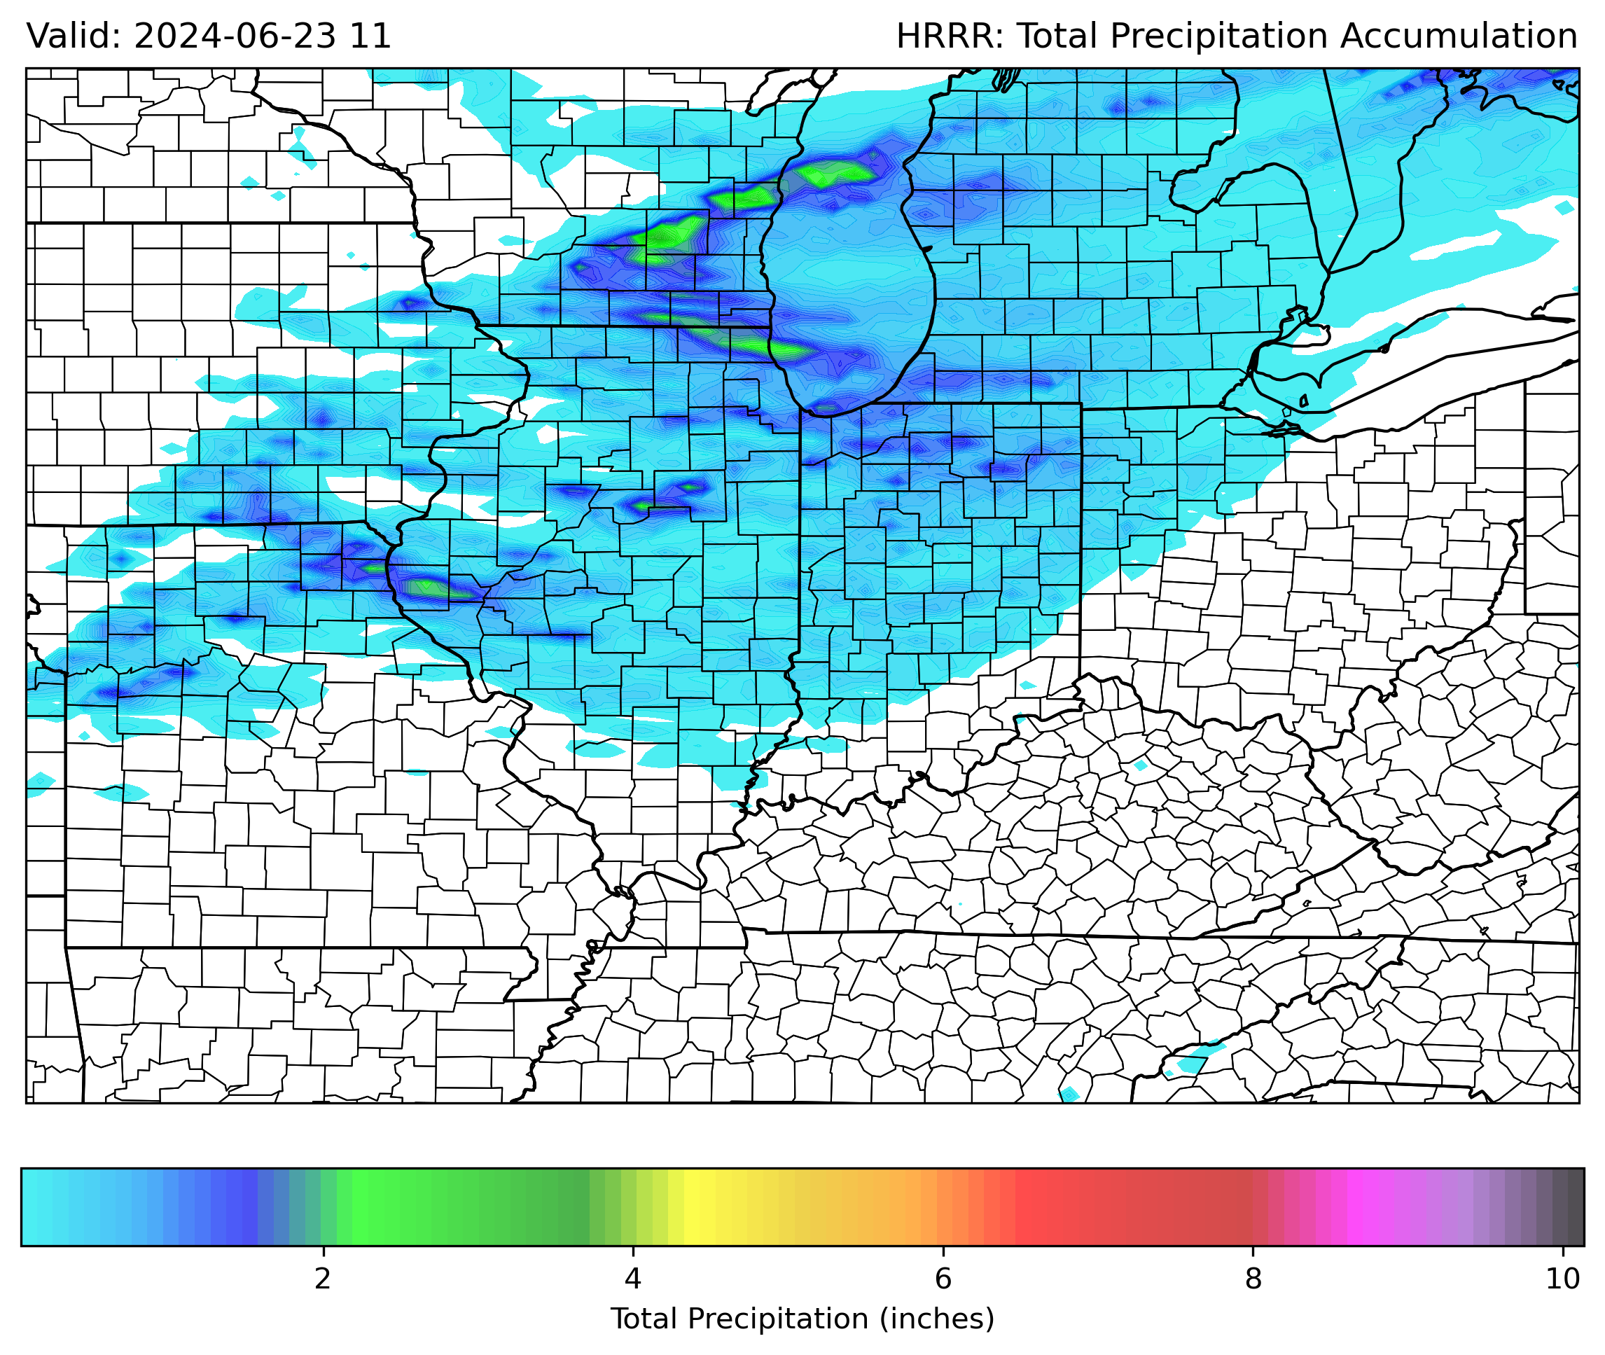
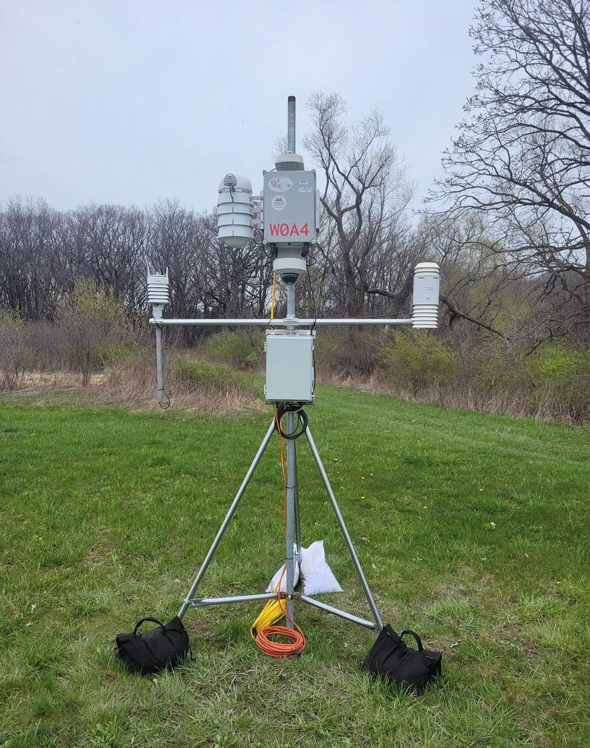
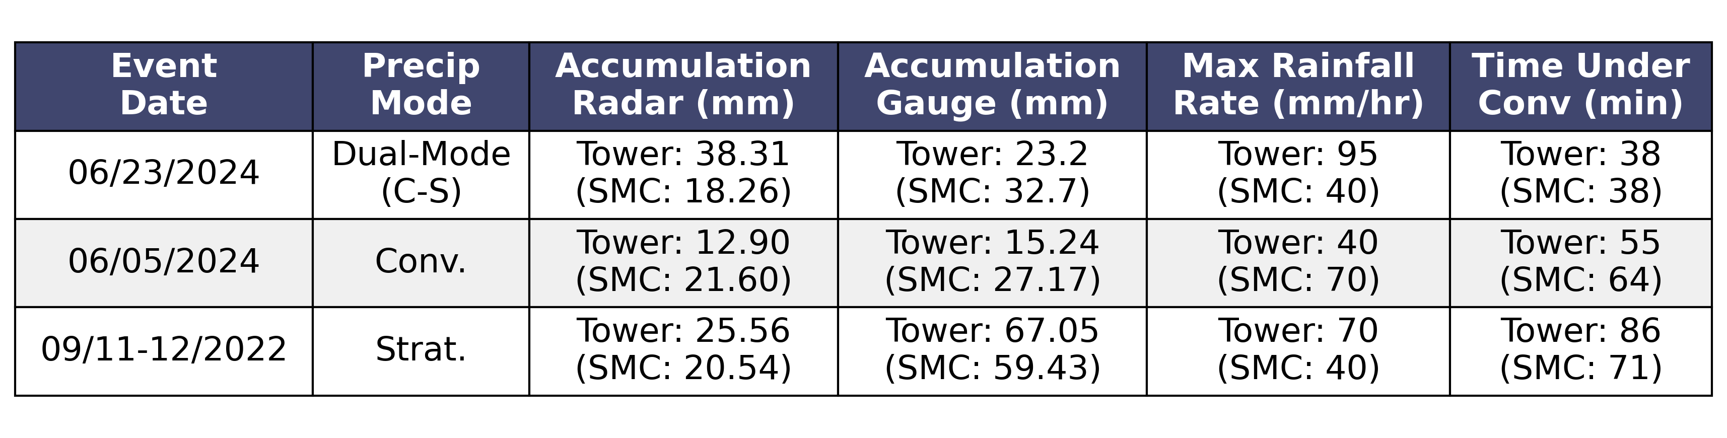

Influence of Micronet locations on hyperlocal precipitation measurements in Chicagoland
Brandon Weart & Joseph O’Brien, Environmental Sciences Division
MOTIVATION
The impact of heavy rainfall and flash flooding is well understood, but the spatial scale over which rainfall accumulation and flooding potential can change remains unclear. While previous studies have found discernable differences in accumulation with a dense network of rain gauges in the Chicagoland area, are these existing networks and observations enough to capture accurate precipitation measurements and extremes?
Rain Gauges at the ATMOS 60 m Tower in Lemont, IL (ANL), and the Sawmill Creek (USGS) will be used as a proxy for capturing local extremes. These gauges are 1.44 miles (2.31 km) apart and provide accurate depictions of rainfall at their respective sites.
Three events covering different modes of precipitation are analyzed and determine whether the current network accurately observes local extremes: June 23rd, 2024 (Convective-Stratiform), June 5th, 2024 (Convective), and Sept 11-12th, 2022 (Stratiform with banding).
Figure 1: CROCUS instruments deployed at the University of Illinois – Chicago Greenhouse.
Multiple python notebooks were created, including one to view vertical reflectivity columns and convective feature detection over each site using the Py-ART software package. A supplemental Herbie notebook was created for model plotting to observe how events were predicted to unfold.
Radar derived rainfall rates were calculated and compared with in-situ gauge observations which allowed us to prove the inaccuracy of remote sensing for precipitation accumulation and further explain why a denser, in-situ network is needed.
CoCoRaHS data was plotted to view community rain gauge data.
MAJOR ACCOMPLISHMENTS
Figure 2: Precipitation comparison showcasing the vertical radar reflectivity column and derived rain rates between ATMOS and Sawmill creek gauges.
Figure 3: CoCoRaHS Data (Left) and 00z HRRR QPF forecast (Right) for the June 23rd event.
FUTURE DIRECTIONS
Results pulled form the vertical column analysis (Fig 2) indicate that convective precipitation is responsible for most rainfall, even within mostly stratiform events. It is also important to note that the intensity of the convective cores over each location are different, and therefore a difference in rainfall rate and accumulation can be observed.
Given the drastic difference in radar and gauge measurements, it is apparent that radar and remote sensing is not adequate for filling in the gaps.
Regional analysis in Figure 3 shows the precipitation forecast compared to the actual observed accumulation, showing some consistency with the location of the maximums, as well as their localized nature.
This code can be used to further analyze other precipitation events to see the differences in the vertical reflectivity profiles over each location, which could further help to prove that rainfall changes over minute spatial distances.
If even more significant differences are noted, the inclusion of other instruments such as disdrometers, could be considered to see how variables such as drop-size distribution change over those small distances.
The deployment of such a network can assist operational meteorology, climatology research, urban development, etc.
RESULTS
Table 1: Metrics for all three events analyzed.
Safety
Adequate PPE was used along with the required job trainings and HEW clearance for field work! If you don’t have those, don’t do field work!
Figure 4: One of the Waggle RDP Nodes used for in-situ observations.
S.A. Changnon, and N.E. Westcott, “HEAVY RAINSTORMS IN CHICAGO: INCREASING FREQUENCY, ALTERED IMPACTS, AND FUTURE IMPLICATIONS 1,” J American Water Resour Assoc 38(5), 1467–1475 (2002).
J.J. Helmus, and S.M. Collis, “The Python ARM Radar Toolkit (Py-ART), a Library for Working with Weather Radar Data in the Python Programming Language,” JORS 4(1), 25 (2016).
Blaylock, B. K. (2024). Herbie: Retrieve Numerical Weather Prediction Model Data (Version 202x.x.x) [Computer software]. https://doi.org/10.5281/zenodo.4567540
Daly, C., R. P. Neilson, and D. L. Phillips, 1994: A Statistical-Topographic Model for Mapping Climatological Precipitation over Mountainous Terrain.
QR Code to GitHub repository for the project
This material is based upon work supported by the U.S. Department of Energy, Office of Science, Office of Biological and Environmental Research’s Urban Integrated Field Laboratories CROCUS project research activity, under Contract Number DE-AC02- 06CH11357 .

Slide 2
Abstract
Precipitation accumulation measurements are known to be accurate for events covering large areas, such as stratiform precipitation. Observations of localized extreme precipitation events, often caused by convective storms, suffer from inaccuracies due to their localized nature, fast motion, and varying intensity over the affected area. Our current measurement system does not account for these issues as it is not dense enough. This study aims to determine the adequate size needed for a network of densely packed in-situ precipitation gauges to fill in the current gaps in our network. Studies at the Argonne Testbed for Multiscale Observational Science (ATMOS) were conducted to find the necessary spacing for capturing these localized convective precipitation events. Comparisons of radar-derived precipitation to in-situ observations for three separate events covering stratiform, convective, and dual-mode precipitation were conducted to discover whether radar can fill the current gaps or if a denser network of in-situ observations is needed.

